Slide 1

IBM Kenexa BrassRing on Cloud
Responsive Apply: Talent Gateway Configuration
October 2017

Slide 2
Agenda
Configuration Overview
Steps to Configure the Responsive Talent Gateway
Responsive Layout Configuration Demo

Slide 3
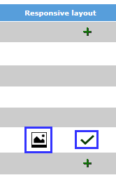
Configuration of the Responsive Apply TG
Responsive job search and apply can be enabled in Workbench for Full and Global Talent Gateways that are WCAG compliant. Basic Talent Gateways cannot be converted to responsive.
Visual Branding Tool:
Screen fonts, colors, images, and Advanced CSS are controlled via the Visual Branding Tool launched from within Workbench. The Visual Branding Tool will be covered in a subsequent webinar.
“Responsive Layout”:
Configured per Talent Gateway with sections that allow you to edit the header, footer, links, verbiage of the site, filters, and fields.

Slide 4



Steps to Configure the Responsive Talent Gateway
The following high-level steps cover how you enable the Responsive settings for the Talent Gateway. Additional webinars are available for the configuration of the Gateway Questionnaires and Visual Branding Tool.
(1) Fill out the initial required settings in the Talent Gateway “Responsive Layout” section by clicking the
icon. (On the Talent Gateways page in Workbench.)
    Once saved, the icon will change to . This icon means that the Responsive layout settings are saved but not yet active.
    Once you complete step 2 the icon will change to . This icon means that the Responsive search functionality is now enabled. Additional configuration will be required.
(2) Enable the Talent Gateway setting called “Talent Gateway Search Layout”
(3) Synchronize Talent Gateways
(4) Brand the Talent Gateway via the Visual Branding Tool
(5) Configure the Responsive Gateway Questionnaire (covered in another webinar session).

Slide 5
Responsive Layout Configuration Demo

Slide 6
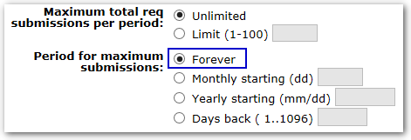
Important Note
Please note that starting July 28th, 2016 (Release 14 Build 20), candidates applying through the Responsive Apply Talent Gateways will be limited to 100 job submissions when the period for maximum submissions setting is set to Forever. (Setting shown below.)
If your Responsive Talent Gateway has this configuration, candidates may receive the error “Application limit reached. Sorry, we only allow 100 applications.” when applying to over 100 jobs.
This limit was put in place to identify and stop serial appliers, and improve overall system performance.

Slide 7
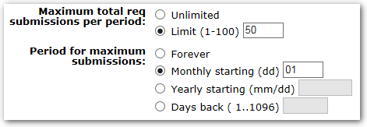
Important Note
You can still change the Maximum total req submissions per period or Period for maximum submissions settings for your Responsive Talent Gateways.
For example, to allow 50 applications per month, your Responsive Talent Gateway settings should look like the below:

Slide 8
Thanks for watching!

