Slide 1

IBM Kenexa BrassRing on Cloud
Responsive Apply: Overview
April 2017

Slide 2
Agenda
What is Responsive Design
Why implement Responsive Apply
Key Features
Estimate Project Timeline
Preparation
Roles and Responsibilities
Steps to Implement

Slide 3
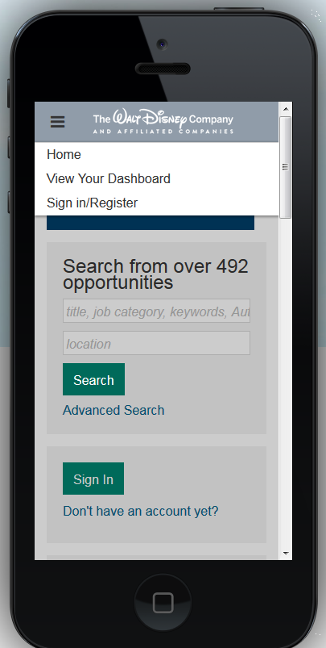
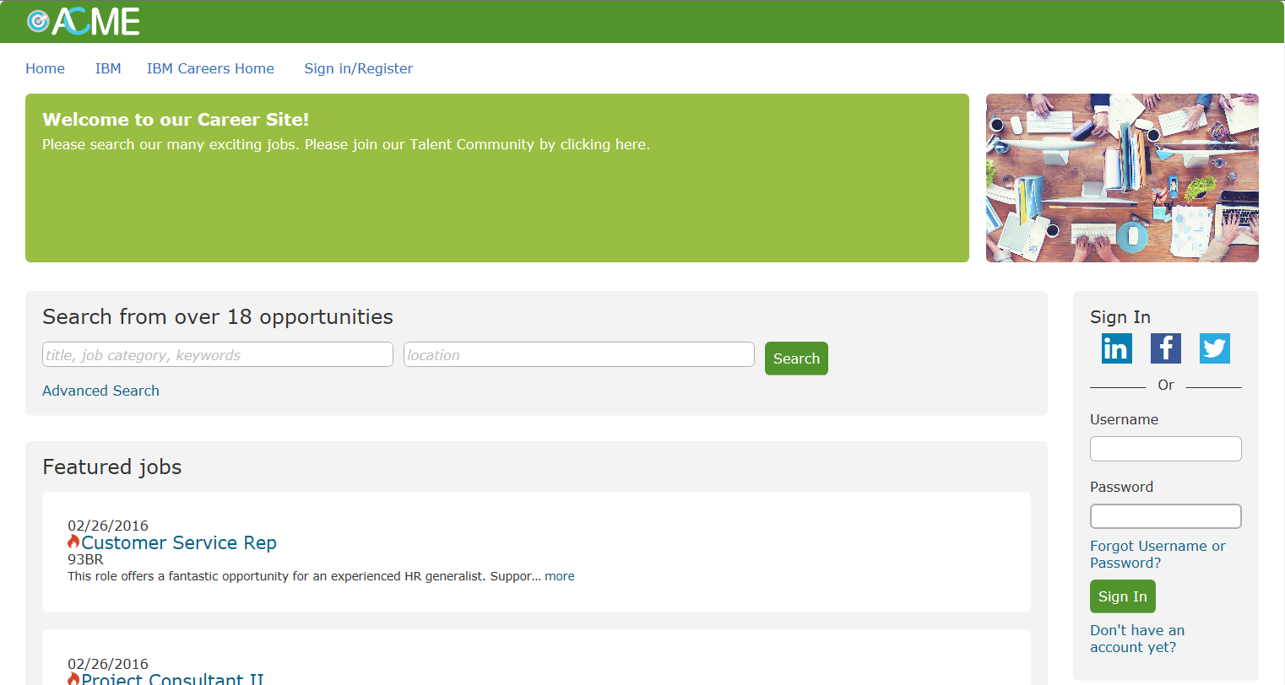
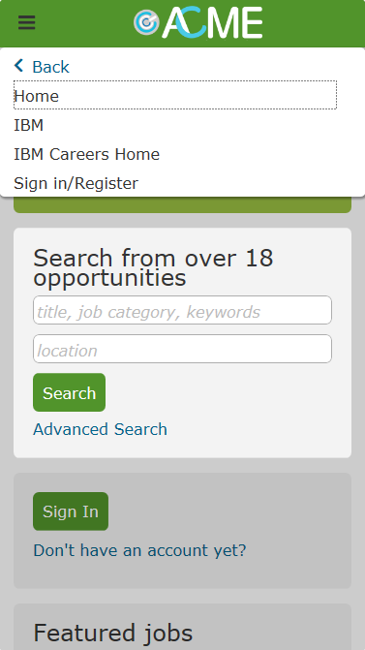
What is Responsive Design?
Responsive design means that the functionality is the same on any device, there are no missing or reduced features between the desktop and mobile experiences.

Slide 4
Why would you implement Responsive Apply?
The new responsive apply modernizes and streamlines your application process. It provides your candidates with a mobile experience that does not differ from their phone, tablet, or desktop. The user interface is clean, easy to use, and can be customized by your organization to match your corporate branding needs.

Slide 5
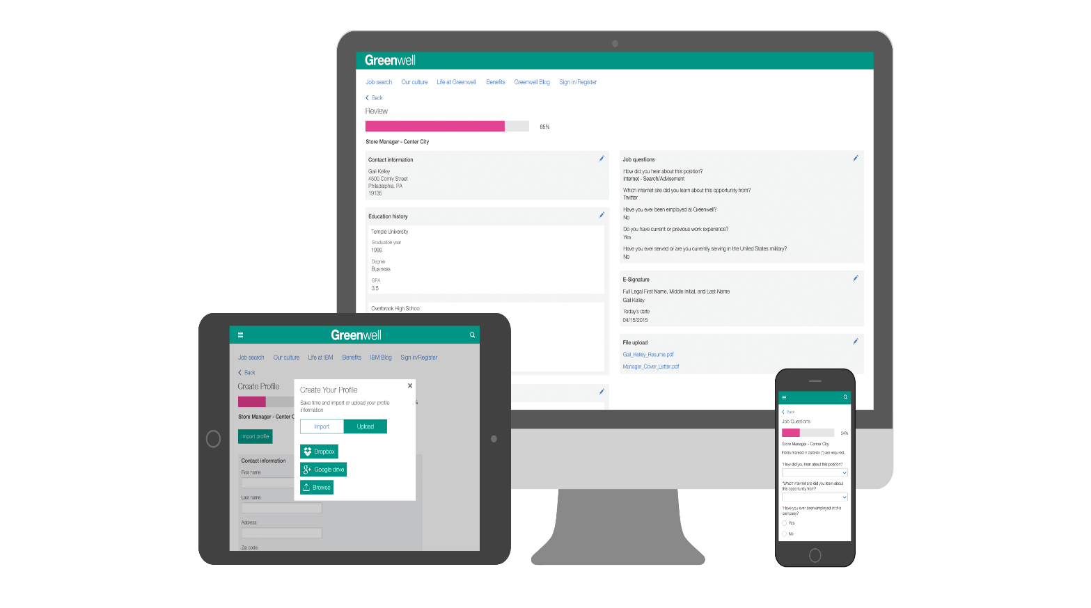
Key Features
Completion of full application on any device: smartphones, tablets, desktops, etc.
Use social media accounts to create or upload profiles
Use cloud accounts or device
browsing to upload resume
& cover letter
Estimated time to complete
the application
Progress bar
Question branching
within the same page
Autosaves as you progress
through the application via continue button
Collapsible in-line text
Global University list
CSS capabilities to brand and
customize the site
Use previous answers from a previous application to reduce re-entering the
same data
Responsive Candidate Zone

Slide 6
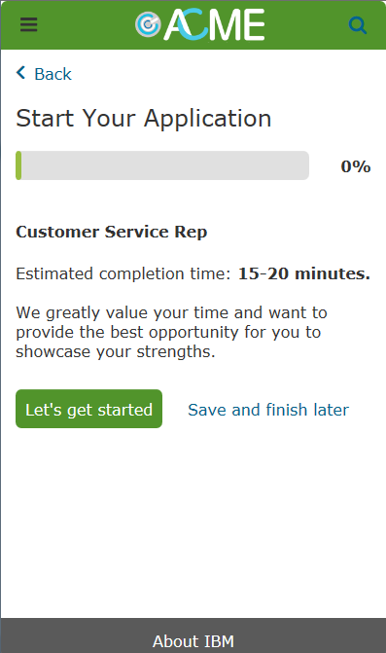
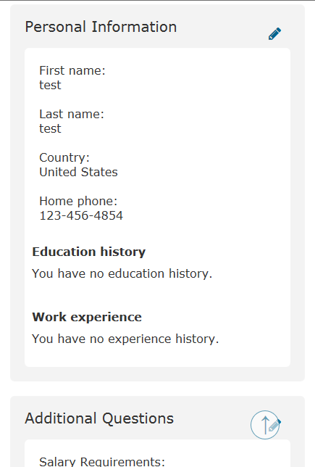
Key Features
Progress bar shows how far along you are in the application (calculated by # of pages already completed / total # of pages).
Estimate completion time: WB Admin can type in the estimated time, OR leave blank to have system calculate (much more accurate).
Every time the candidate presses ‘Save and finish later’ the progress and any work done on that page is saved automatically. Candidates can resume at a later time, on a different device if they choose. Candidates can review and edit their application before submittal.
Candidates can review and edit their application before submittal

Slide 7
Estimate Project Timeline
Milestone | Week
Kick-off & Prep | Week 1
Design/Branding Complete (1 week) | Weeks 1 - 2
Configuration (2 weeks) | Weeks 2 - 4
UAT (1 week) | Week 5
Go-live (2-day prep needed) | Week 6

Slide 8
Preparation
Pull in additional teams/vendors that will be critical to completion of the project (listed on following slide)
Do you currently utilize Gateway Questionnaires (GQs)?
  If yes: Your Gateway Questionnaire format will change slightly. Review how many GQs you will need to update, and take this time to simplify and streamline your process.
  If no: Request that the GQ functionality be enabled. This request can be made to your IBM representative.
Review your site and the current Responsive Apply configuration options
Which Talent Gateways will you be converting?
Review your corporate career site.
  Do you use an iFrame?
  Do you have a vanity URL?
  Where do your external BrassRing Talent Gateways connect with your corporate site? How are your internal Talent Gateways accessed?
What vendors currently scrape your Talent Gateway(s)?

Slide 9
Roles and Responsibilities
Workbench Administrator: Will be responsible for configuration throughout the project. This includes the Responsive Gateway Questionnaires and Responsive Talent Gateways.
Recruitment/Talent Acquisition Team: Provide insight on process improvements during User Acceptance Testing and may want to provide feedback on current functionality.
Marketing/Corporate Communications: Will be responsible for providing branding details (including potential CSS), will review the gateways to ensure branding compliance, and may be needed to make the appropriate corporate career site changes.
Legal: Review the application process, especially the VEVRAA and 503 Disability forms (if presented to candidates).
Job Board Vendors that may be scraping the Talent Gateway(s): Scraping is not available on the Responsive Apply Talent Gateways. Vendors that scrape will need to move to the IBM Jobs API to pull requisition information.

Slide 10
Steps to Implement
Kick-off call:
  Discuss any configuration items you noticed during prep
  Discuss roles and responsibilities – including who is responsible for configuration, branding, testing, go-live activities, etc.
  Discuss high-level timelines
  Provide design sheet to have the marketing/corporate communications team. Make your legal team aware of the review they will be asked to complete. Start reaching out to your vendors that may be scraping your Talent Gateway(s).
Marketing team to provide branding details for Talent Gateways (via the design sheet)
IBM team member to enable client setting for Responsive GQ
WB Admin/IBMer will complete the initial configuration in Workbench. Additional feedback may be needed by the Recruitment and Marketing teams during configuration.

Slide 11
Steps to Implement
Initial review will be completed by all teams and configuration changes will be completed by the WB Admin.
Test reqs should be posted to the Responsive Talent Gateways to allow for testing to occur.
User Acceptance Testing
    Recruitment team will be responsible for UAT testing the Responsive Talent Gateways and apply process (Responsive Gateway Questionnaires).
    Marketing/corporate communications team will be responsible for reviewing the branding on the Talent Gateways. (URLs should be sent to these teams for review.)
    Vendors that scrape the Talent Gateway(s) will want to test the Jobs API
    Configuration changes will be completed as needed throughout the UAT step.
    UAT sign-off
    Go-live date is set

Slide 12
Steps to Implement
Go-live
    WB Admin/IBMer will complete configurations in Production. (Example go-live checklist below)
      (Pre go-live) Enable client setting for Responsive GQs
      (Pre go-live) Move Responsive GQs to Production
      (Pre go-live) Configure Responsive Layout Page in WB
      (Day of go-live) Enable TG settings (Responsive Setting, etc)
      (Day of go-live) Activate GQs (Update associations if the client is already using GQs)
      (Day of go-live) Remove Default Questions (if needed)
      (Day of go-live) Configure branding in Visual Branding Tool
      (Day of go-live) Refresh/Repost reqs postings
  Client’s marketing/corporate communications teams will complete URL changes if necessary.
  Vendor(s) start utilizing the jobs API to pull jobs.

Slide 13
Thanks for watching!

