Slide 1

IBM Kenexa BrassRing on Cloud
Responsive Apply: Gateway Questionnaire Configuration
April 2017

Slide 2
Agenda
Responsive Gateway Questionnaire Overview
Responsive Gateway Questionnaire Widgets
General Steps to Configure Responsive Gateway Questionnaires
Responsive Gateway Questionnaire Configuration Demo

Slide 3
Responsive Gateway Questionnaires
Responsive apply requires that you create and use a responsive Gateway Questionnaire (GQ). Responsive GQs have the following features.
One-column layout - The layout for a responsive GQ is one column. Headers and footers dynamically adjust based on the device viewing them.
Improved Preview - The Gateway Questionnaire Preview functionality has been improved to show the responsive layout and allows for candidates to click directly into the section they would like to edit before submitting.
New Sections/Pages - Saving a classic questionnaire as new or creating a new responsive GQ adds four new standard sections and three visible text widgets. The new sections and widgets are required for all responsive questionnaires, and cannot be removed or deleted.
Responsive Gateway Questionnaires are differentiated from Classic Gateway Questionnaires by the responsive icon next to the GQ name in workbench.

Slide 4
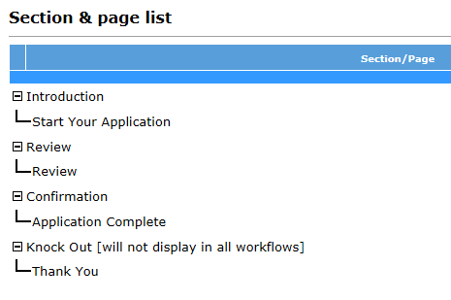
Responsive Gateway Questionnaires
The 4 new standard sections of the Responsive Gateway Questionnaires are:
Introduction > Start Your Application (which must always be first)
Review > Review (Review page doesn’t include a widget)
Confirmation > Application Complete
Knock Out > Thank You
These sections and pages are automatically added when the “Responsive” setting is enabled on the GQ Properties page.

Slide 5
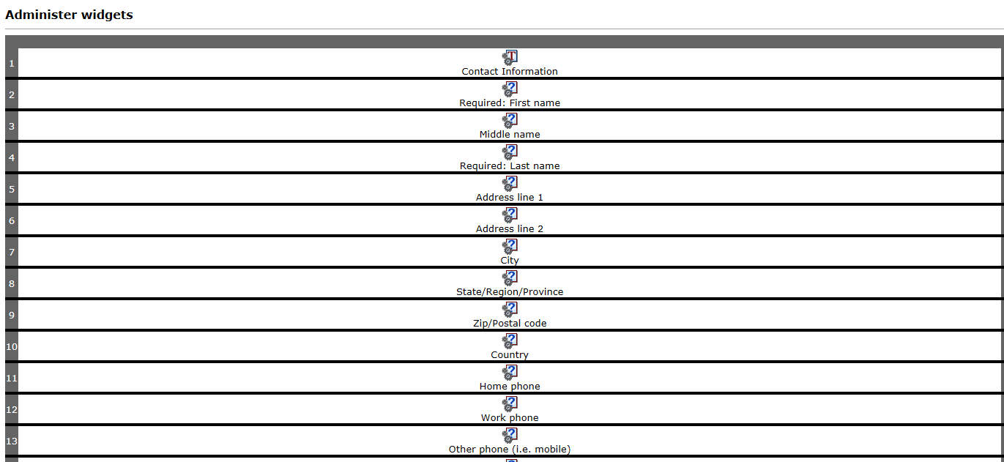
Responsive Gateway Questionnaires
Widgets within the pages are now all in a single column, to accommodate responsive screens of smaller devices without horizontal scrolling.
When you add or delete a widget, it now automatically adds or deletes the row – no more need to create a row, then the widget.
You can cut-and-paste widgets before or after the selected widget.

Slide 6
Responsive Gateway Questionnaires Widgets
Text widgets - Text widgets attributes have been streamlined to only have two attributes, with a single descriptive text box (to be used for both single and multiple reqs). The “Use as subheading” setting allows the text to be used as a subheading, under which any widgets that follow are grouped (until the next subheading text widget or end of page).
Complex widgets - The following complex widgets can be used in Responsive Apply:
  Resume upload
  Cover letter upload
  Education builder
  Experience builder
  Job Specific questions
Question widgets – The classic question widget formatting attributes such as font style and alignment have been removed. The formatting of these fields are handled by the responsive design.
Attachment widgets – The attachment widget can now be added to the responsive apply gateway questionnaire to allow candidates to upload and attach documents to their application. Only 1 attachment widget is allowed per page, but you can configure multiple categories within an attachment widget.

Slide 7
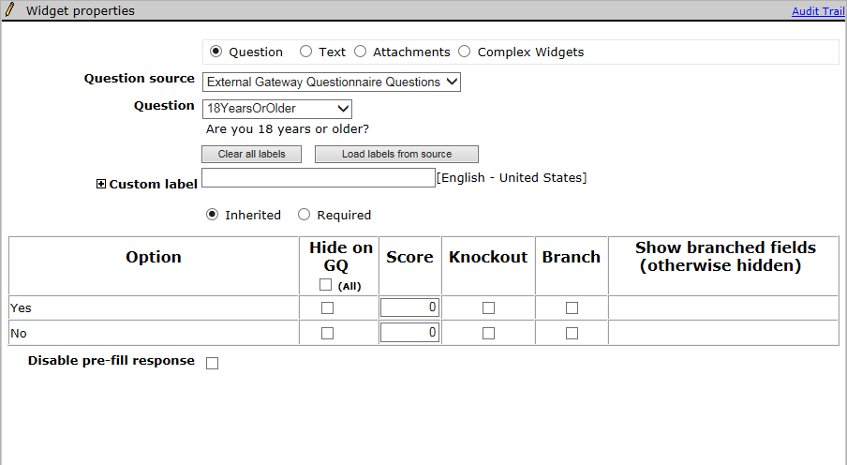
Responsive Gateway Questionnaires Widgets
The scoring, knockout, and branching functionality are all configured on the Widget properties page for the Question widgets.
The Disable pre-fill setting is hidden for candidate contact fields. In classic GQs, you can disable pre-filling of fields with responses from prior applications for any question widget, including contact fields. In Responsive Apply, you can disable pre-filling for candidate form questions only. This restriction improves the candidate experience by pre-filling more of the candidate’s information from their current application.

Slide 8
Notes / Best Practices
To avoid confusion for BrassRing users, have one page per section for responsive questionnaires, and use the same title for both section and page. Standard sections/pages can have different name. Since BrassRing users see only section titles, and candidates see only page titles in the candidate experience, keep the names the same to minimize confusion.
The “Introduction/Start Your Application” section/page MUST be the first section/page of the Responsive Gateway Questionnaire.
The “Estimate time to complete” field on the “Start Your Application” page sets the time estimate that the candidate sees before they start filling out their application. Leave this field blank to have the system calculate the estimate time using an advanced algorithm based on the number and type of questions and widgets in the application. You can also enter your own estimate manually, should you prefer that method.

Slide 9
Notes / Best Practices
The Review page is where the candidate can edit and review their responses prior to submitting their application. There is no configuration needed on this page.
The Application Complete page:
  Is the confirmation page that lets the candidate know their application has been successfully submitted.
  The text on this page can be customized.
  Select the “show TG HR Status link (“View your status”)” setting if you would like your candidates to be able to go directly to the submission check page.
  Select the “show TG Search link (“Start a new search”)” setting if you would like your candidates to be able to return to the Welcome/Search page to start a new job search.
Responsive Gateway Questionnaires are limited to 1 knockout page for the entire GQ.

Slide 10
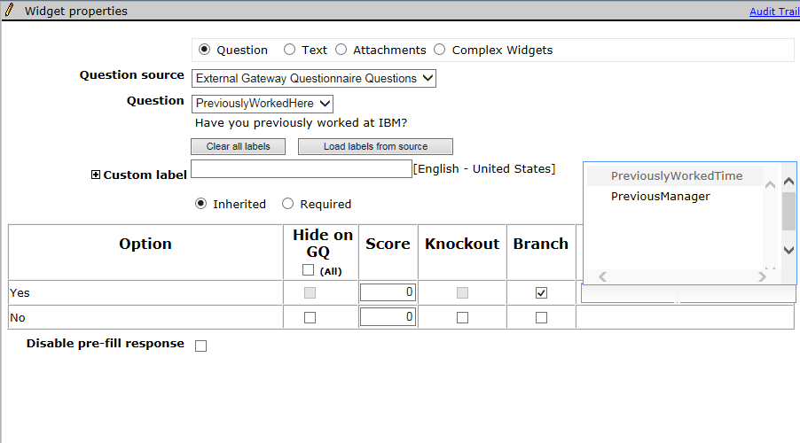
Responsive GQ: Question Branching Configuration
Branching Configuration:
Add all questions that may be branching questions or questions that will need to be shown as a result of a selection to the page.
In the widget properties page for the ‘parent’ question choose the fields that will show based on the option selected. Select “Branch” for the option you want to show the branched fields, then under the “Show branched fields” section select the fields you want to be visible if the option is selected. The Show branched fields section will autocomplete as you type. Fields shown are the database field names so it is important to know which field you are selecting.

Slide 11
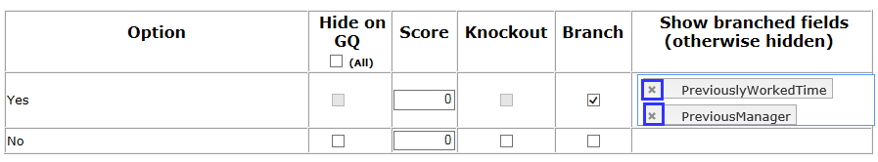
Responsive GQ: Question Branching Configuration
Branching Business Rules
You can branch only from question to question – you cannot branch to a text widget. However, to display variable text, you can create a label for that text in the candidate form, and branch to that label – and the corresponding text.
Branching must be linear. You cannot branch to a widget that precedes the question widget in the widget order. Thus, if you select the first widget on the page, you can choose to branch to any of the following fields on the page. If you select the last widget on the page, no fields will be available to branch to.
A child field can’t be reused on the same page as the branched-to field after being used on the page already for a different widget.
You can branch across forms, as long as the fields are pulled on to one GQ page.
Classic GQ page-level branching is not inherited when you create a responsive GQ. Branching must be re-configured.
To remove branches, select the X in the branch label tag.

Slide 12
Gateway Questionnaire Configuration Steps
The following high-level steps should be followed if your organization is NEW to using the Gateway Questionnaire functionality:
Determine how many Responsive GQs you will need. This could be based on:
  The number of Responsive Talent Gateways you have. (One GQ per TG)
  The number of different application workflows you have. (One GQ per Job Family/Position)
  The number of countries your organization operates in. (One GQ per country.)
Map out your application process/flow. Most organizations that have not used GQs in the past will implement one GQ per TG. Examples: Internal, External
In Workbench, go to Tools > Gateway Questionnaires > Add new Gateway Questionnaire > Name your GQ (we recommend you use versioning such as “External v1”) > Set your other GQ properties > Save
The 4 standard responsive sections will automatically be visible. Next, add the Sections, Pages, and Widgets that will make up your application process.
Activate the Responsive Gateway Questionnaire
While posting your requisitions to the Responsive Talent Gateway, be sure to select your Responsive Gateway Questionnaire.

Slide 13
Gateway Questionnaire Configuration Steps
The following high-level steps should be followed if your organization is NOT NEW to using the Gateway Questionnaire functionality:
In Workbench, go to Tools > Gateway Questionnaires > Click the Active tab > Select the Classic GQ you’d like to turn into a responsive GQ > “Save Gateway Questionnaire as New” > Name your GQ and make sure the “Responsive” setting is selected > Click OK
The 4 standard responsive sections will automatically be added to your existing GQ sections. Some reconfiguration may be required to ensure your application process flows properly.
  Pages have been updated to the 1 column format which may require you to re-configure the order of your questions.
  Branching and knock-out questions will have to be reconfigured.
  Text throughout the Gateway Questionnaire should be re-reviewed.
Activate the Responsive Gateway Questionnaire
Select your existing Classic Gateway Questionnaire > Click “Update Gateway Questionnaire associations” > Select your new Responsive Gateway Questionnaire > Inactivate the old/classic GQ.

Slide 14
Responsive Gateway Questionnaire Configuration Demo

Slide 15
Thanks for watching!

