Slide 1

IBM Kenexa BrassRing on Cloud
Responsive Apply: Visual Branding Tool
April 2017

Slide 2
Agenda
Visual Branding Tool Overview
Steps to Configure in the Visual Branding Tool
Advanced CSS Overview
Advanced CSS Examples
Visual Branding Tool Configuration Demo

Slide 3
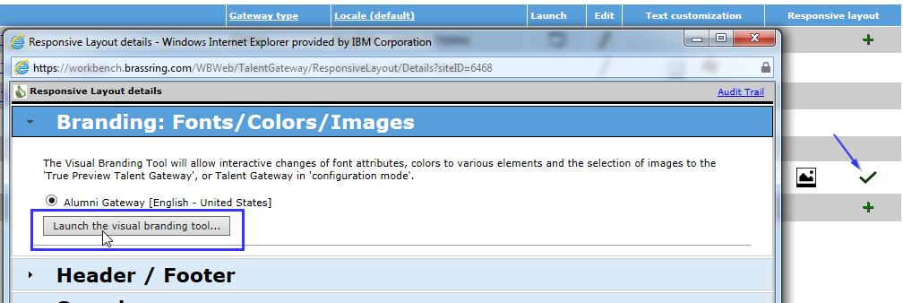
Visual Branding Tool Overview
With the Visual Branding Tool (VBT), you can change and save branding elements for responsive Talent Gateways and Gateway Questionnaires: colors, fonts, and stored images. Gateways must be:
Full or Global WCAG-enabled Talent Gateways
Have saved responsive layout (indicated by pencil or checkmark icons)
Be synchronized if new or if responsive layout was recently configured.
To Access the VBT you can select Tools > Talent Gateways >
Alternatively, you can click the responsive layout checkmark icon for any Talent Gateway, expand the “Branding: Fonts/Colors/Images” section, and click the “Launch the visual branding tool” button.

Slide 4
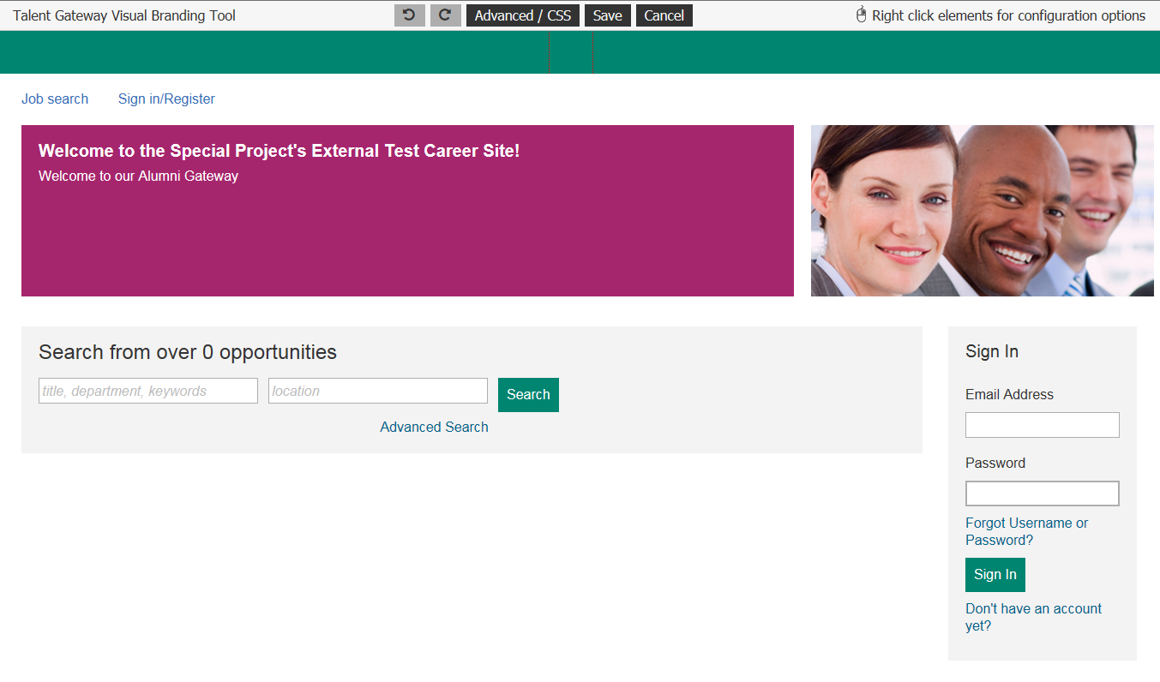
Steps to Configure in the Visual Branding Tool
VBT opens in configuration mode, where you can right-click to change the different elements.

Slide 5
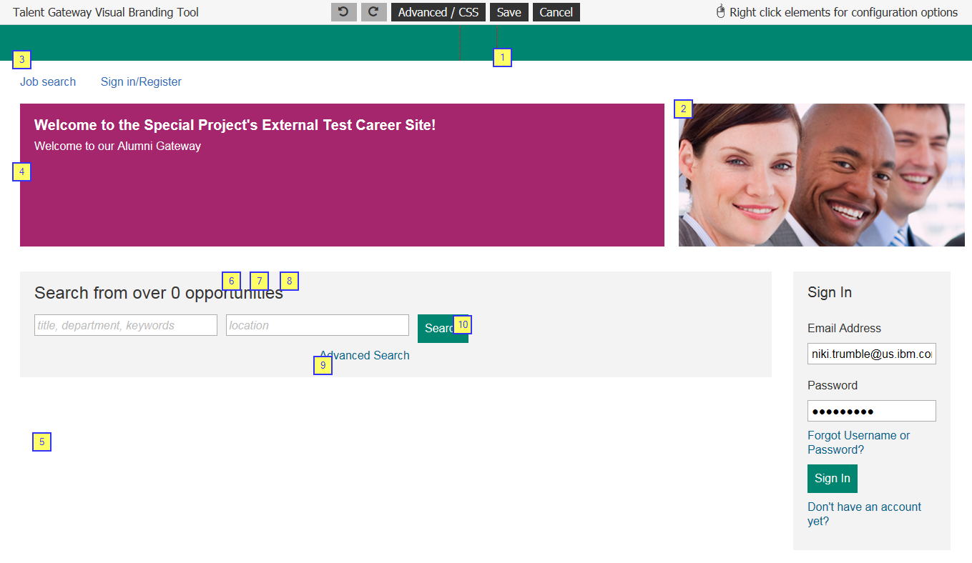
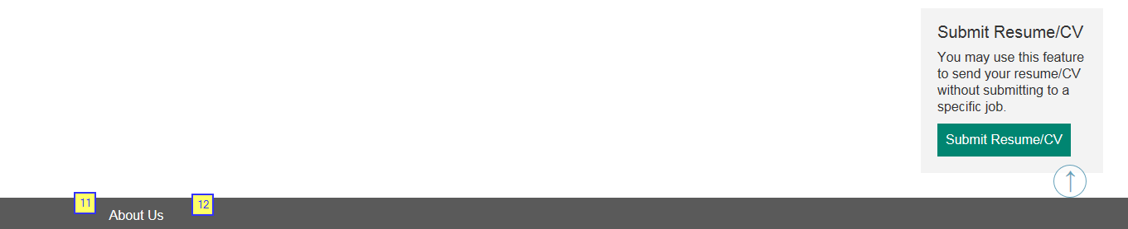
Steps to Configure in the Visual Branding Tool
1: Logo – Will appear in the header. Must be a URL and HTTPS hosted. Height 50px, Width 130px, Size 50kb
2: Branded Image – Must be a URL and HTTPS hosted. Height 400px, Width 1100px, Size 600kb
3: Header Link Color
4: Foreground Color
5: Background Color
6: Base Font Size – 16px default
7: Base Font Color
8: Base Font Style: Helvetica Neue/Arial, Verdana, Times New Roman, Tahoma
9: Page Link Color
10: Button Background Color
11: Footer Font Color
12: Footer Background Color

Slide 6
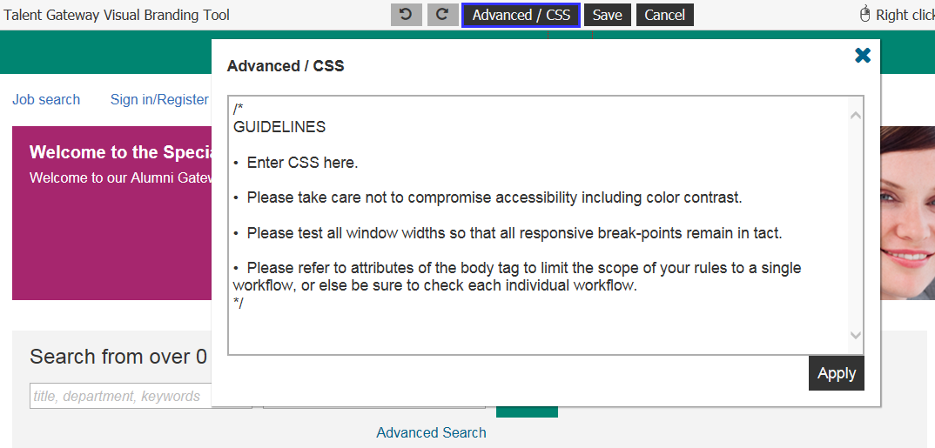
Advanced CSS
At a very high level, CSS (Cascading Style Sheets) replaces the formatting of certain HTML tags in page content; you could make a special icon appear for any use of the <li> bullet tag, or you can control the colors of certain elements universally. CSS normally can be used in-page or as a separate HTML document called for each page. To learn more about CSS, you can access this online source.
The Advanced / CSS feature in the visual branding tool was created to allow clients granular control over branding through the direct input of CSS code. Advanced CSS allows you to add CSS scripts to change the look and feel of the responsively designed pages.

Slide 7
Advanced CSS
The Advanced CSS feature is very powerful, and as you manipulate the CSS on a page, you may negatively affect the responsiveness or the accessibility of the application pages, so please make sure the CSS script entered is done by someone with deep expertise in CSS. The candidate experience has been coded to adhere to numerous global standards and to accommodate virtually all devices through responsive design. In addition to solid knowledge of CSS, the Advanced CSS option of the visual branding tool requires great care to avoid adversely affecting all of the following:
  Responsive breakpoints
  General usability
  Accessibility
The tool is not intended to re-write the entire CSS, it's intended use is for specific changes that need to be made.

Slide 8
Advanced CSS
What It Can Do: The Advanced CSS option can control the presentation of every element in the user interface: header, footer, and main body. Such as:
Control colors and fonts
Hide content
Resize content
Reposition content
Add background images
Add and remove scroll bars
Add some content (text, icons, images, etc.) within limitations
Show content that was otherwise hidden
Change the number of columns displayed (within some limitations, excluding IE < 10 and Opera Mini)
What It Cannot Do
It cannot always single out a single element in the user interface to restyle without affecting similar elements
It generally cannot divide content or make any changes that require changes to markup
It generally cannot control user interaction or make any changes that require changes to script.

Slide 9
Advanced CSS: Examples
The background and input boxes on the Welcome page in Responsive Apply are square. In order to make them rounded, you can use this script:
div, p, span, input, button, textarea, img.backgroundImage, ul, li{
border-radius: 6px !important;
}
div.pageHeader, div.pageFooter{
border-radius: 0 !important;
}

Slide 10
Advanced CSS: Examples
To widen the search input boxes so the keywords show, you can use the below scripts to add breakpoints to increase the width as space allows, which is most devices and screen widths:
  @media only screen and (min-width: 1100px) {
  /* increase width of search landing page search inputs when there's space */
  #gateway #initialSearchBox .controlWrapper.autocompleteWrapper {
  display: inline-block;
  min-width: 26em;
  }
  #gateway #initialSearchBox .powerSearchLink{
  width: auto;
  }
  @media only screen and (min-width: 1200px) {
  /* increase width of search results search inputs when there's space */
  #gateway .sidebarVisible .sidebar {
  width: 370px;
  }
  #gateway .sidebarVisible .sidebar + .listContainer {
  margin-left: 370px;
  }
  #gateway .mainContainer{
  max-width: 1200px;
  }
  #gateway[workflow=jobDetails] .mainContainer{
  xmax-width: 1100px;

Slide 11
Advanced CSS: Examples
Below are some options for the header logos through CSS changes.
Larger Main Header Logo
/*larger main header logo*/
/*simply adjust the value for height*/
/*the width will automatically adjust preserving the aspect ratio*/
body#gateway .primaryHeaderLogo{
height: 80px;
}
Left Aligned Main Header Logo
/*left aligned main header logo*/
body#gateway .primaryHeaderLogo{
float: left;
margin-left: 12px;
}

Slide 12
Advanced CSS: Examples
Show the Secondary Header logo (configurable in the VBT once shown)
/*show the secondary header logo configurable in the VBT once shown*/
/*this CSS shows it just to the right of an already left aligned main header logo*/
/*the left value would need to be tweaked based on the proportions of the main logo*/
/*once again the height value will control both height and relative width*/
body#gateway .secondaryHeaderLogoWrapperLink{
padding: 8px 8px 4px 8px;
display: block;
position: absolute;
left: 230px;
top: 9px;
}
body#gateway img.secondaryHeaderLogo{
height: 40px !important;
}

Slide 13
Thanks for watching!

